Slide 1
Mobile Medical Information for the Deaf
By Siphokazi Dayile
Supervisor I Venter
Co-Supervisor WD Tucker

Slide 2
Quick Recap
Problem
Deaf people have limited access to illness information
Proposed Solution
A mobile application that will help Deaf people access illness information using a mobile phone

Slide 3
User Interface Specification
Home Screen
User instructed to enter a query

Slide 4
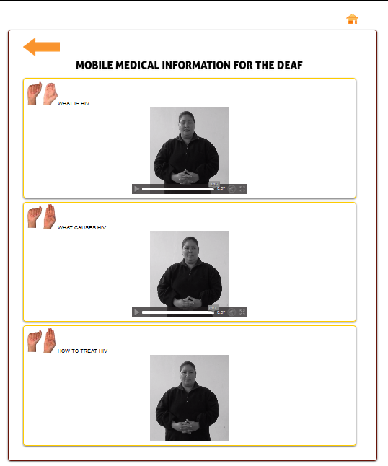
UIS
List of video’s displayed related to the user’s query

Slide 5
UIS
User play the video

Slide 6
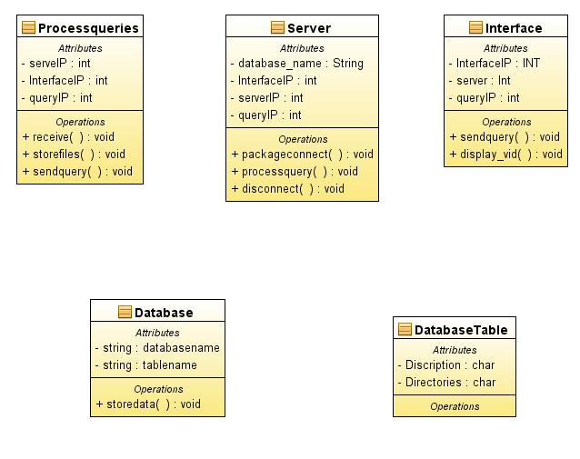
High Level Design

Slide 7
Low level Design
split query into separate words
for each word in query
get video containing the word from database
if this video is in the score table
add concurrent word occurrences on the video to the score table
if this video is not in the score table
add the video to the score table and store current word
occurrences for this video in the score table
create a container to return the video
retrieve video information from database and store
Return container

Slide 8
Project Plan
Term | Task
2 (Modelling and design ) | Correct documentation Read through the UIS,OOA and OOD by looking at previous projects Update website UIS documentation Revise UIS Start planning the prototype OOA write up OOD write up Hand in documentation
3 (Implementation) | Edit Documentation Make changes to objects pseudo code Read about MSQL database and decide on what structure to use to store information

Slide 9
References
• A, F. (2005). Improving the deaf communities access to prostate and testicular cancer. BMC public health.
• Adcock J, M. C. (2005). Towards effective indexing for very large video sequence database. Brisbane: University of Queensland.
• April L, W. D. (2003). Deaf and hard of hearing HIV prevention needs. BMC Public health.
•J, S. (2000). Challenges and techniques for effective and efficient similarity search in large video database. Brisbane: University of Queensland.

Slide 10
Demo
Demonstration of UIS
User enters query
User view result

Slide 11
Questions

